Slide 1

North Country Community College
Thu 3/28/2024 10:00 AM - 12:00 PM

HH-105 Join Zoom Meeting;
Meeting ID: 874 5440 2488;
Passcode: 291180
Business Advisory Board
March 28, 2024 in person in Saranac Lake and via ZOOM – this meeting will be recorded

Slide 2

President’s Welcome –
Business Programs Advisory Board – Spring 2024
1. Greetings and Gratitude
    Importance of advisory boards
      Community-College connections
      Curriculum relevance
      New opportunities
      Preparing students for careers/transfer
2. College Updates
    23-24 Enrollment
    Empire State Community College Workforce Guarantee
      NYS Budget Request for Operational Funding increase
    County Support
      23-24 Operational funding increase
    Capital Updates and Needs
    Opportunities
Notes:
Background of Spring 21 plan…rolling average of positivity % is 15x what it was in August 2020.

Slide 3
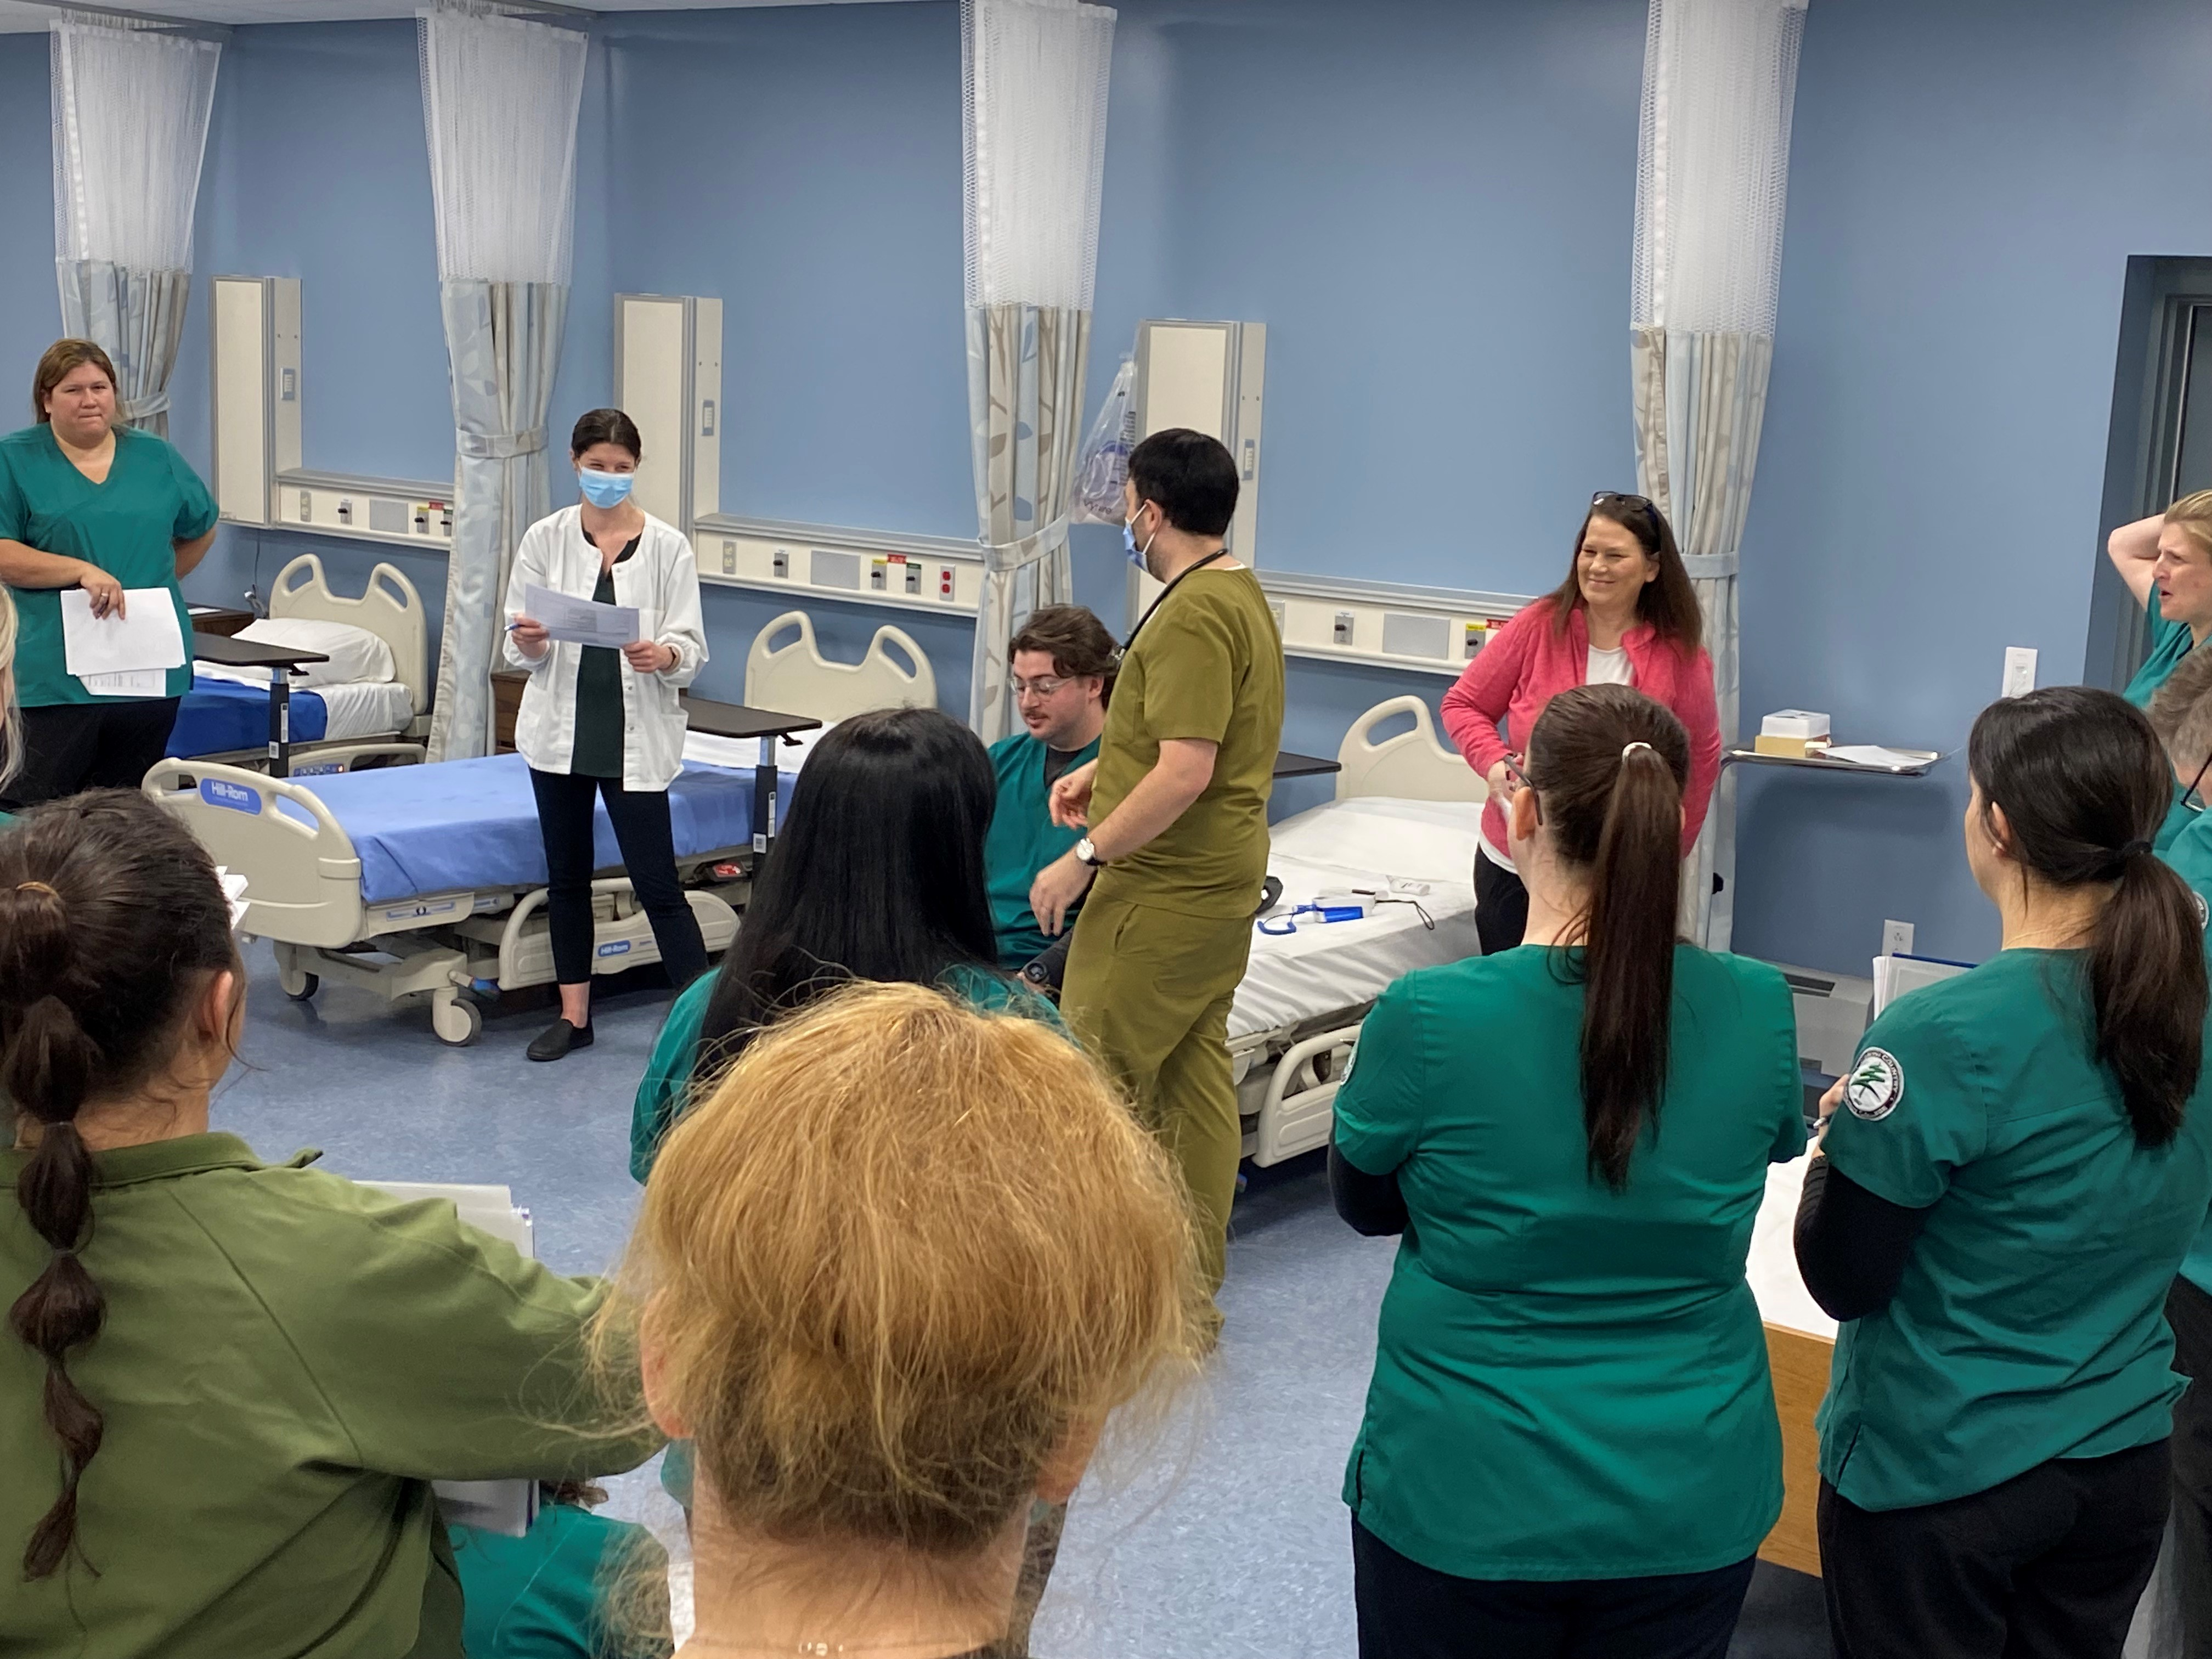
*Nursing Labs and Simulation Equipment
*Science Lab Renovations

Slide 4

Approved by New York State Education Department
One-Year Certificates
Digital Advertising and Design Certificate
Teaching Assistant Certificate
Online Programs—new approvals
AAS Human Services (95% online)
AS Child and Family Services (95% online)
AS Cybersecurity and Digital Forensics with Herkimer College
AAS Chemical Dependency Counseling (Distance Learning format--95% online)
Non-Credit Offerings—Spring 2024
*Child Development Associate Certificate (May 21st – August 13th)
*Software Engineering Bootcamp (April 23rd – July 9th)
*Pottery Classes: (March 19th-April 25th; May 7th-June 13th)

Slide 5

Interim CFO Report to Business Advisory Board 2024
NCCC AAFTE Enrollment Trends
New Initiative Impacts
NCCC Financial Projections
Improving the Operating Deficit
Healthy Fund Balance
Business Program Enrollment Trends
2nd Chance Pell Program (incarcerated students)
In/Out of State Students
Notes:
Background of Spring 21 plan…rolling average of positivity % is 15x what it was in August 2020.

Slide 6

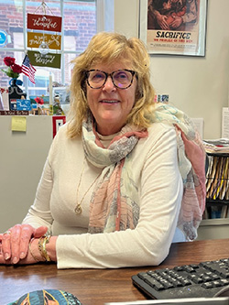
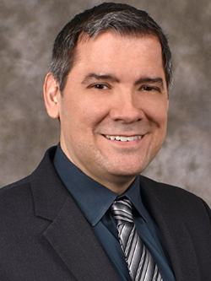

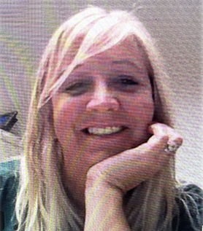
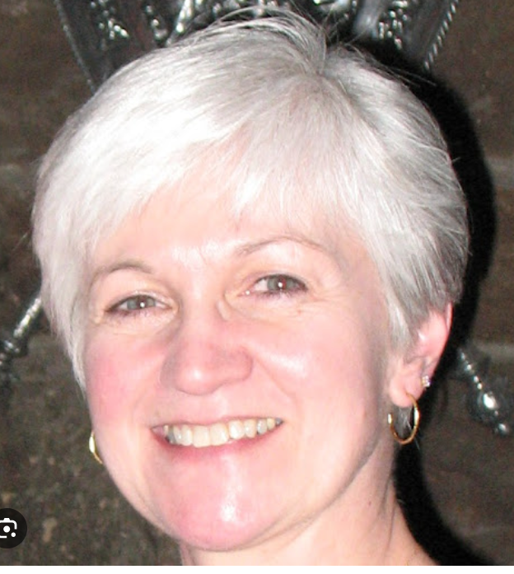
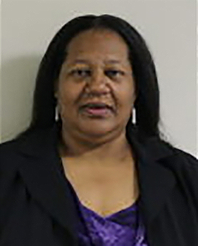
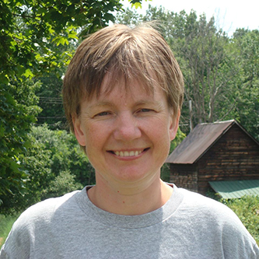
Business Department Faculty
Adjunct Faculty
(including Second Chance Pell Instructors*):
Sarah Boyce*
Steven Brewer*
Regina Derzon*
Lynne Fisher Kemp
Gerald Lambert*
Diane Litynski*
Nataliya O’Neal
Kelly O’Shields
Madaline Toliver
Full Time Faculty:
Kim Duffey - Chair
Tom Callahan*
Robin McGrath

Slide 7
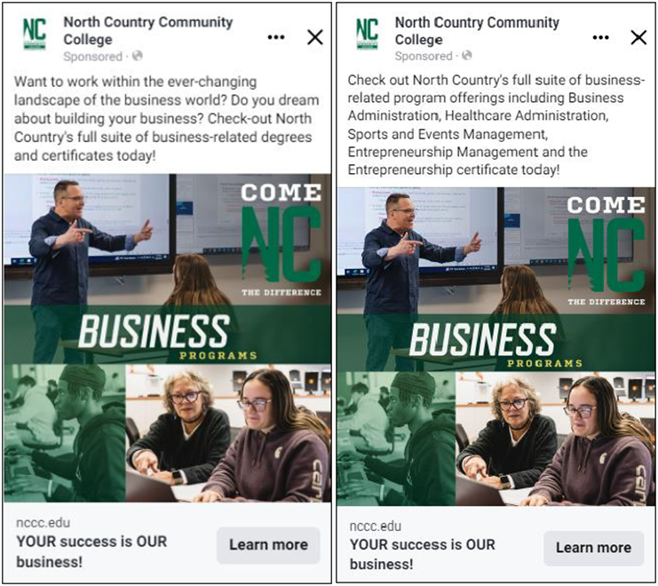


Marketing Updates:
Ongoing Programmatic Campaigns & Marketing:
  Next Business & Entrepreneurship campaign will run from 6/1 – 6/30
  Transfer Programs ran in Dec/Jan
  New promo videos and marketing pieces
Continued Adult Learner Campaigns
  "6 on Us" designed for those seeking to give college their first (or another) try
  "Opportunity Scholarship“ to lessen cost for those who don’t receive other scholarships
Enrollment Updates:
Enrollment Team Upcoming Events:
  Spring Travel Season
  Explore North Country Day
  Summer MASH Camps (3-4 Locations)
Fall 2024 Application Volume
  ​Business Admin AS: 64 (33 in 2023)
  Business Admin AAS: 48 (23 in 2023)
  Healthcare Admin: 7 (6 in 2023)
  Entrepreneurship AAS: 10 (8 in 2023)
  Entrepreneurship Cert: 9 (4 in 2023)
  Sports & Events Mgmt: 79 (44 in 2023)
Kyle Johnston
VP - Marketing & Enrollment

Slide 8

Business & Graphics Collaboration
Course Dual Designations
    Students share an interest in business and
    creative design opportunities
    Crossover between disciplines
      - Website Design
      - Intro to Computer Graphics
      - Publication Design
Competent and accomplished Professors:
      Tina Lamour https://tinyurl.com/4yvarmzx
      Elaine Taylor Wilde https://tinyurl.com/yd9b9v8b
3. The Future Collaboration
    Certificate: 1 year focus on
    Advertising & Design

Slide 9

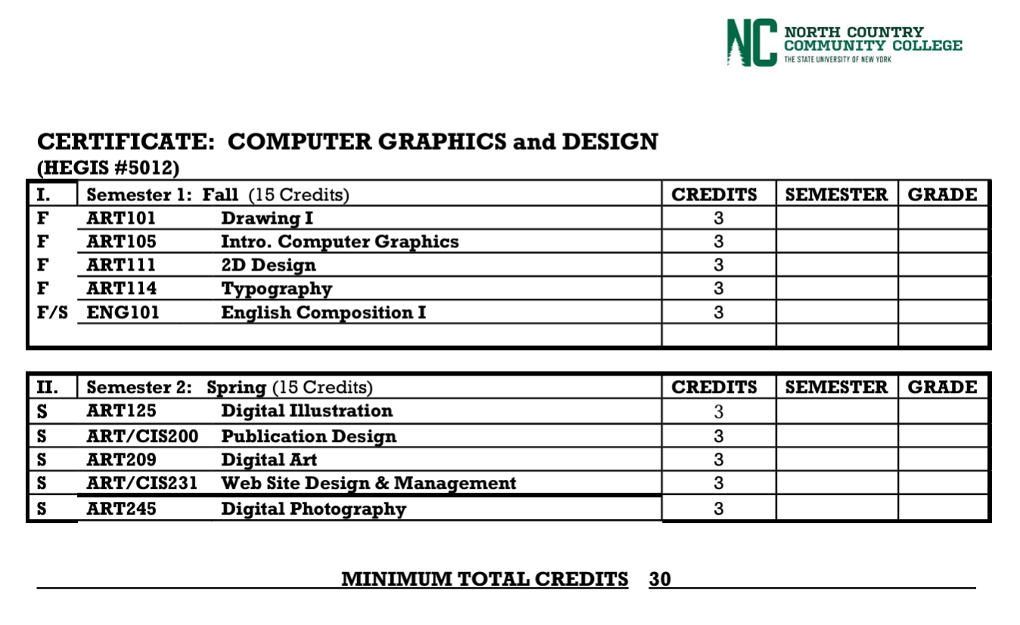
Computer Graphics & Design Certificate
Graphic Design and Business basics in one year
Covers the basics for Entrepreneurs
Courses available online
Financial Aid available

Slide 10
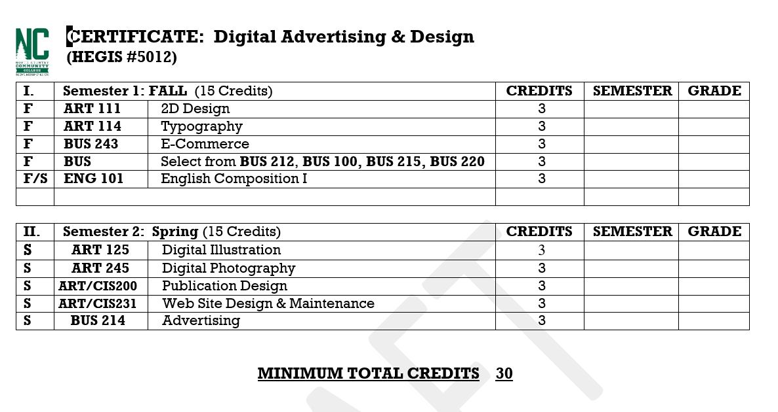

Digital Advertising & Design Certificate
Blending BUSINESS and DIGITAL ARTS
Covers the basics for Entrepreneurs
Courses available online
Financial Aid available
Making money is art and working is art and good business is the best art. – Andy Warhol 1969

Slide 11
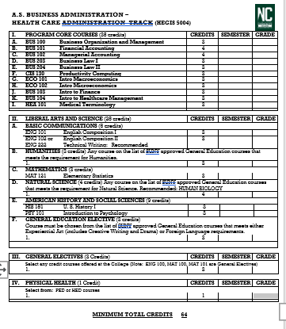



A.S. Business - Health Care Management Degree Track
PATHWAY to SUNY Canton 4 year degree
The B.S. in Healthcare Management’s curriculum focuses on business fundamentals and the healthcare related foundational and skills-based courses that touch on technology, healthcare finance and economics, managed care, quality standards, and foundations of management and business. Some sample courses are: Managed Care, Healthcare Finance, Healthcare Economics, Public Health, Legal and Ethical Issues in Healthcare, Quality and Patient Safety, Health Information Technology, and Healthcare Facility Administration.
For working professionals and students interested in an online degree .
Flexible - Students can attend online or in person classes at the SUNY Canton campus
Topics include – U.S. Healthcare system and its functions, health care facility administration, healthcare finance, public health, information technology, legal and ethical issues in healthcare,
Internships are part of the curriculum – and opportunities abound for student placement in the North Country and beyond
CONTACT - Marella Fiacco – fiaccom@canton.edu phone: 315-386-7444
https://www.canton.edu/business/health_care/

Slide 12

Second Chance Pell Program –
Tom Callahan – NCCC faculty instructor/advisor
Sarah Kilby – NCCC faculty administrator for program
Incarcerated individuals earn 2 year Associates degrees
Program name: Second Chance PELL (after the grant)
Now in all prisons in the area:
      Bare Hill Correctional- Malone
      Franklin Correctional-Malone
      Adirondack Correctional-Ray Brook
      Federal – FCI Ray Brook
      Student grads from SCP are starting new businesses:
      Example: one student started a transportation "Flagging" business after release
      During course work he discovered from his research that all NYS funded projects must give 10% of contracts to minority businesses
      This grad reports that his business is flourishing
Notes:
Background of Spring 21 plan…rolling average of positivity % is 15x what it was in August 2020.

Slide 13


SUMMER 2024 Course Offerings
You don’t need to be a full-time student to get some knowledge under your belt
Cost of less than $1000 including books and online access
Courses are ONLINE
Dates: May 28, 2024, to August 2, 2024
BUS 100 – Business Organization and Management – Prof. T Callahan
    Course covers all aspects of business
    From management to finance to governance to law – this course is an eye-opener for staff and managers
    Instructional resources utilize the most recent text/publisher online interactive technologies
CIS/ART 105 – Intro to Computer Graphics – Prof. Elaine Taylor-Wilde
    Course focused on computer software and hardware components for graphics
    Principles and processes employed in the dynamic field of computer graphics.
CIS 130 – Productivity Computing – Prof. Kelly O’Shields
    Course covers Windows applications and Microsoft Office 2018 +
    Online interface through D2L and publisher software
Notes:
Background of Spring 21 plan…rolling average of positivity % is 15x what it was in August 2020.

Slide 14


A.S. Sports and Events Management
Location – top recreation & events destination
Internships
ORDA, Lake Placid
2023 World University Games
Athletic Facilities
Online course options
Transfer options, campus location

Slide 15
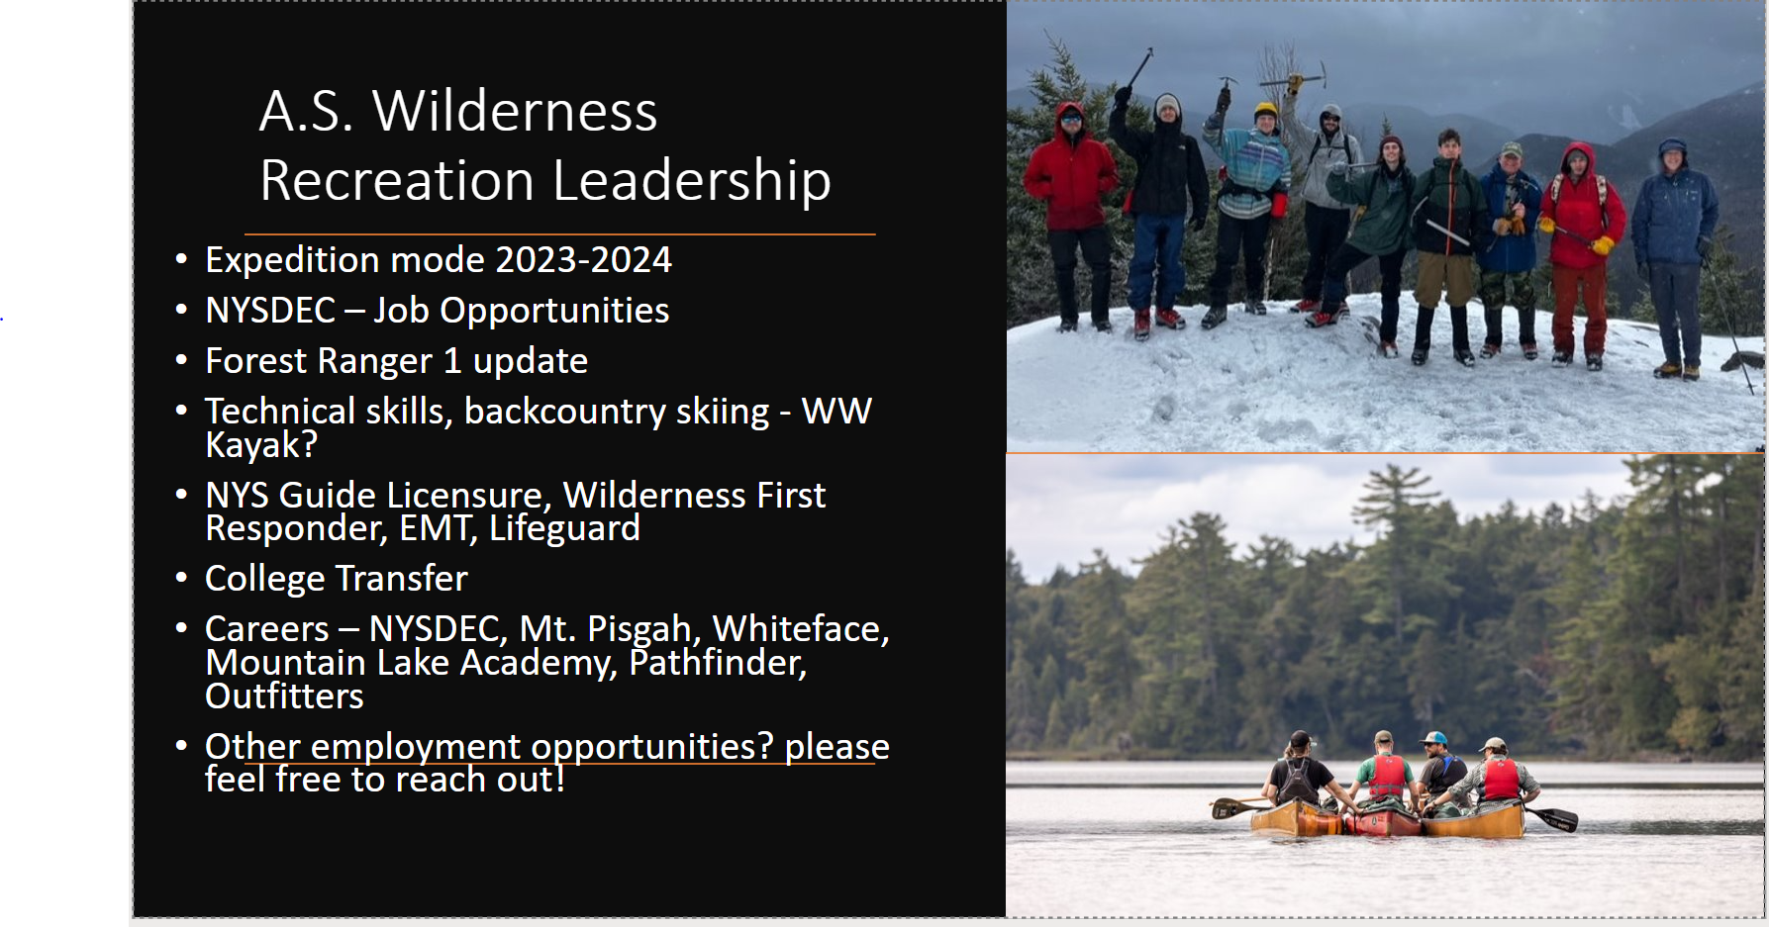

Slide 16
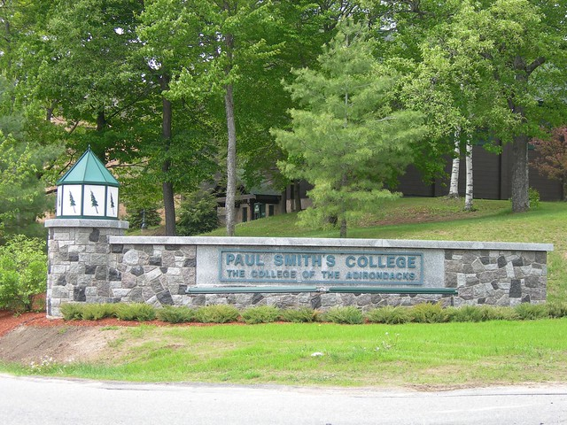

2 PLUS 2 – start at NCCC – Finish at PSC
2+2= YOU partnership - allows all past and future North Country Community College graduates the SAME state-level tuition rates for THE LAST TWO YEARS AT PAUL SMITH’S!
PSC has Bachelors in:
  Management (concentrate in Corporate, Sports, eSports, Entrepreneurship)
  Digital Marketing
  Recreation and Adventure Tourism
  Sport Management
  Communication
  Hospitality
  Psychology
FOR INFO Email:
Sarah Maroun - smaroun@nccc.edu or
Diane Litynski - dlitynski@paulsmiths.edu
https://www.paulsmiths.edu/admissions/2plus2/#:~:text=How%3F,while%20remaining%20in%20the%20Adirondacks.

Slide 17
Student Affairs – Advisory Board Report 2024
Career & Transfer Services
      Services - Job Readiness Presentations, Mock Interviews, Resume Critiques
      Strong Interest Inventory®
      College Central Network®
      nccc.edu/student-support/career-services
      nccc.edu/transfer-services
    Student Leadership
      SGA – one governing board for all three campuses
    Counseling Partnerships
      Citizen Advocates on campus – Saranac Lake & Malone
      Peer Advocates initiative from NCCC Human Services Dept.
      SUNY Student Tele-Counseling through Upstate Medical
      nccc.edu/counseling/
Personal Growth
Inclusion
Leadership Development
Wellness
Future Planning
Academic Success
Notes:
Background of Spring 21 plan…rolling average of positivity % is 15x what it was in August 2020.

Slide 18




Slide 19

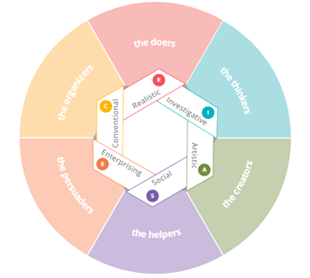
As part of the College’s efforts to build upon our existing Career Services, we recently purchased a number of Strong Interest Inventories through this year’s Perkins Grant.
Strong Interest Inventory assessment helps individuals identify their work personality by exploring their interests in six broad areas.
It then breaks the areas into 30 specific areas of interest that can be directly related to fields of study, careers, and leisure activities.
In addition, it describes an individual’s personal style preferences in five areas: work style, learning environment, team orientation, leadership style, and risk taking.

Slide 20


Slide 21

MicroCredentials – We need your input!
WHAT IS IT? A micro-credential is a short, competency-based recognition that a student can earn in a short period of time
SUNY LINK:
https://www.suny.edu/microcredentials/microlist/)
What the Business Department is considering: micro credentials for:
Non-profits and grant writing
Health care business credentialing
Business basics for farmers

Slide 22


ADVISORS: What do YOU think?
Your opinion is the reason we are together today….and we value your time, talent and input
Share your thoughts: HOW:
- should we proceed with MICRO CREDENTIALS in business fields?
-What credentials resonate with you?
- NCCC might improve on preparing students for transfers to 4 year colleges… or directly to careers?
- can the Business Department be better attuned to and respond to community needs?
-Other ideas?

Slide 23

North Country Community College and its Business Department thank you for honoring us with your presence!
We appreciate your commitment to the college and to our students
If you have any questions, comments, ideas or items to share – please email or call any of us all the year through.
Kim Duffey kduffey@nccc.edu 518-521-5133 cell or text
This meeting will be recorded and the recording accessible on our Business Department homepage – bottom right https://www.nccc.edu/business/

